Slide 1
EMG-driven Quadcopter Agricultural Irrigation System
Phase-2
Group 27
Zhu Zhu, Junnan Liu, Chenglong guan, Longfei Zou
13/03/2024

Slide 2
CONTENTS
1
Selected Technology and its importance
2
Importance for Disabled
3
System Explanation
4
Function of Subsystem
5
Conclusion
6
Reference List

Slide 3
PART 1
Selected Technology and its importance

Slide 4

Source:https://www.unoosa.org/oosa/en/ourwork/space4sdgs/
Notes:
(SDGs) Sustainable Development Goals, objectives, established by the United Nations in 2015, which are aimed to be achieved by 2030

Slide 5



Our goals in SDGs
Source:https://www.unoosa.org/oosa/en/ourwork/space4sdgs/
Notes:
As part of Phase 2, we focus on two significant technologies to achieve our goals in Zero Hunger (SDG2), Good Health and Well-Being (SDG3), and Reduced Inequalities (SDG10).

Slide 6
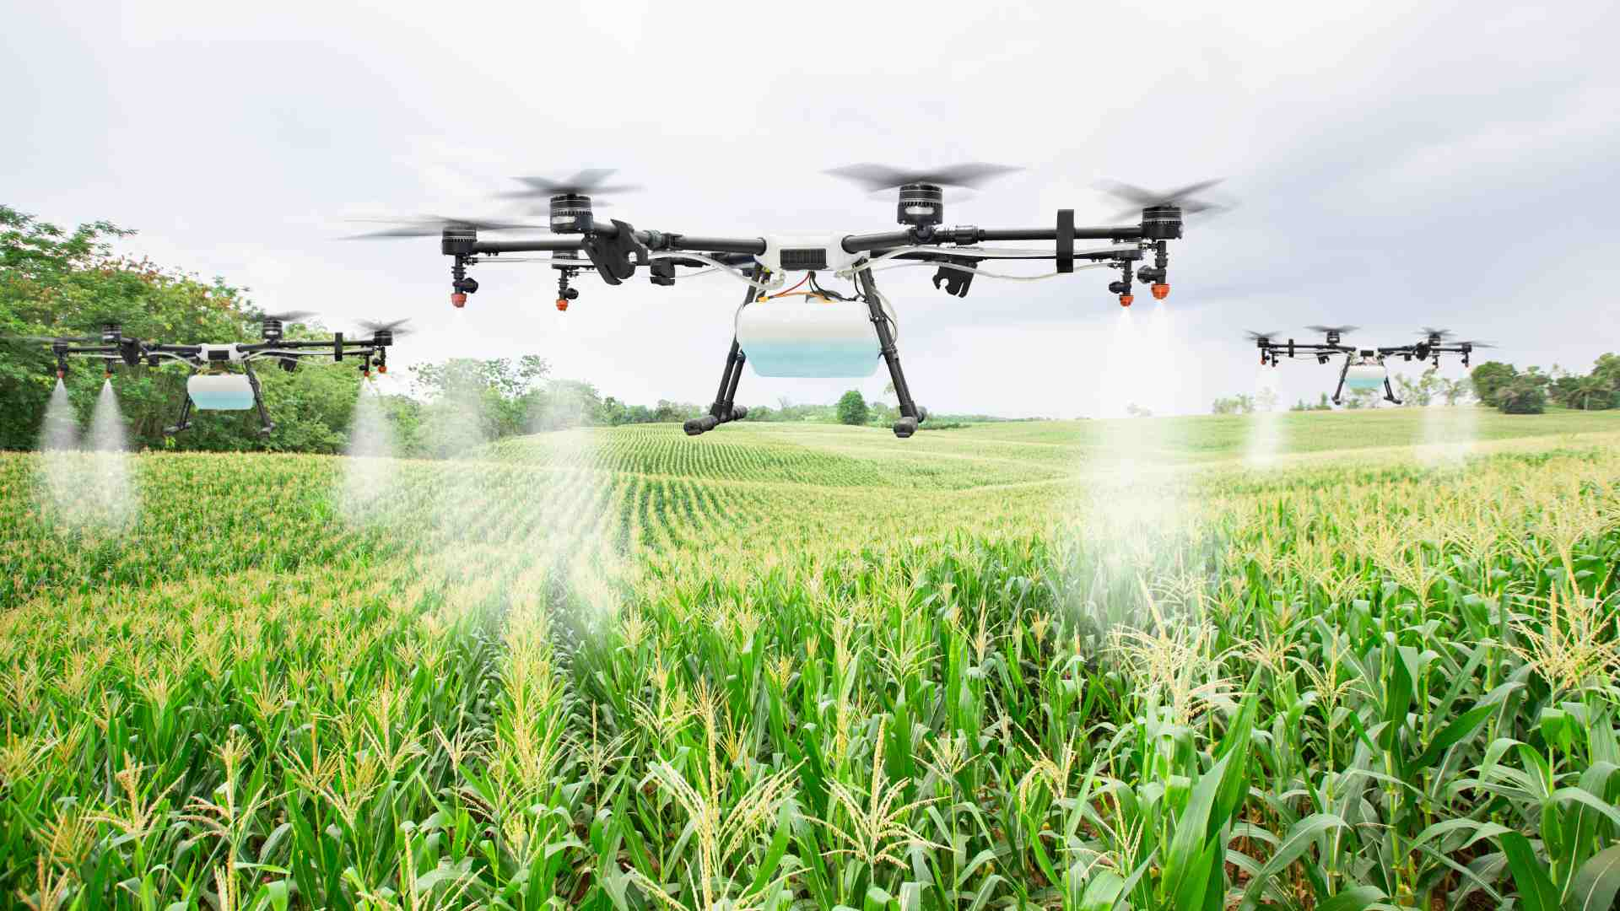
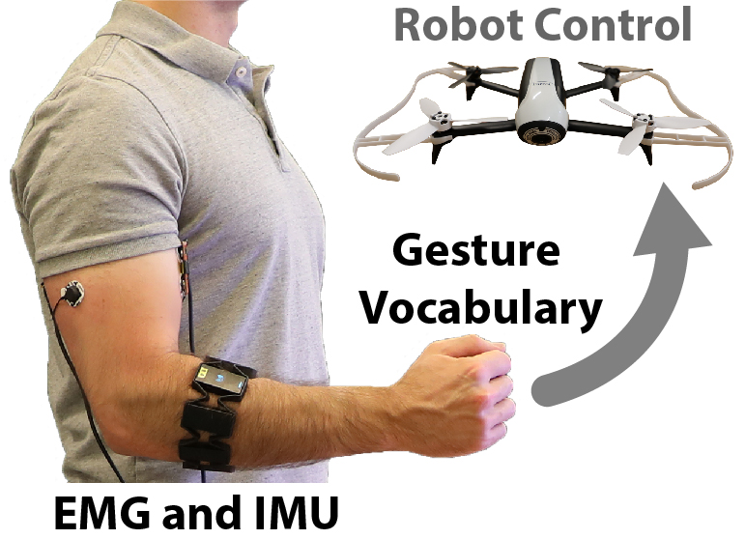
How to achieve our SDGs ?
Source:https://aster-fab.com/producing-more-with-less-precision-farming-to-feed-10bn-people/
Precision
Agriculture
EMG Based
Control of UAV
Source:https://dl.acm.org/doi/abs/10.1145/3319502.3374823?cid=99658989019Multi-Drone
Notes:
The first technology is the application of UAV in precision agriculture, which plays an important role in achieving Zero Hunger (SDG2) and really potential in the future.
The second one is the EMG(Electromyography) Based Control of UAV (Unmanned Aerial Vehicle) which is a simple and effective way to permit not only amateur users but also some disabled people to control the UAV.

Slide 7
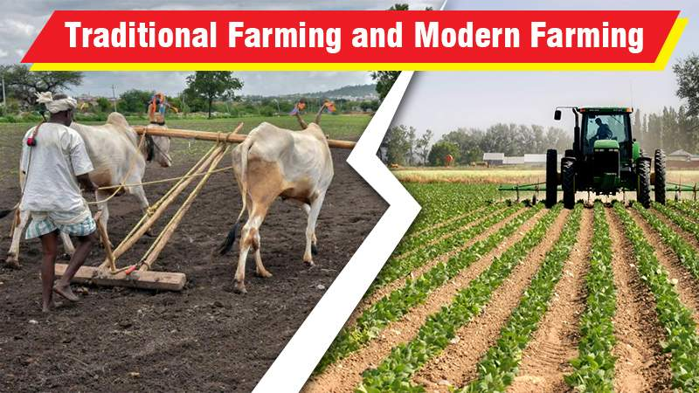
Precision Agriculture
1. Plant Diseases & Pests
2. Productivity
3. Efficient & Cost-Effective
Source:https://khetigaadi.com/blog/traditional-farming/
Notes:
Nowadays, most of developing countries need to improve the crop productivity. For example, over 70% people are living by farming in India. However, conventional agricultural methods fall short due to challenges like plant diseases and pests, underscoring the divide between developed and developing countries.
To reduce such inequality(SDG10), we can use relative technology in the precision farming which is more helpful and benefitial for productivity.
Using remote sensing technology, precision agriculture can be implemented based on pre-existing maps of targeted variables. Remote sensing offers an efficient and cost-effective method for farmers to collect data, visualize, and analyze the condition of crops and soil throughout various stages of the growth cycle.

Slide 8
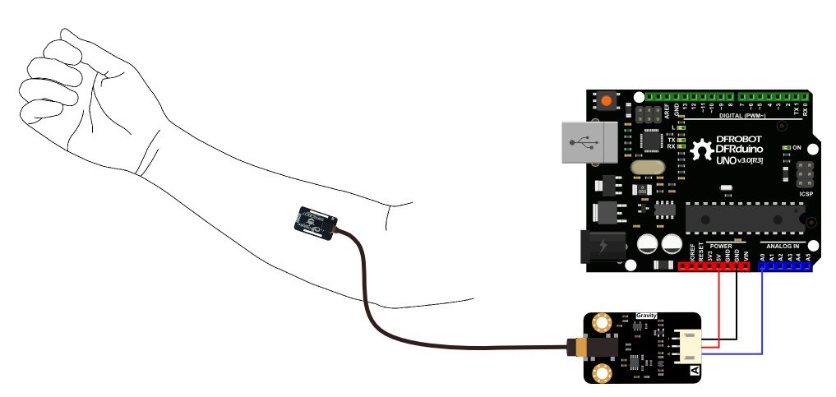
EMG Based Control of UAV
1. Easy to learn
2. Healthy Field
3. Digitalize & Productivity
Source:https://botland.store/gravity-medical-sensors/10833-dfrobot-gravity-analogue-emg-sensor-6959420912780.html
Notes:
This method offers considerable advantages, particularly for persons with disabilities, by leveraging EMG signals. Therefore, we want to use the EMG to control the drone which is simple and easy, even disabled people can learn it quickly. Based on the application of UAV in agriculture, it's also important for crop productivity.
In this way, it's also helpful to achieve our goals of Good Health and Well-Being (SDG3) and Reduced Inequalities (SDG10).
The field of health benefits significantly from EMG technology. Prompt diagnosis is essential and of great importance in medical practices. By comparing the health profiles of individuals who are healthy with those who are not, it becomes possible to facilitate the early detection of not only Alzheimer's disease but also Parkinson’s disease.

Slide 9
PART 2
Importance of promoting the employment of people with disabilities

Slide 10
Profile of the disabled population and current employment situation
Figure 1-Disability Prevalence in the General Population and Employment Rates Among Persons with Disabilities of Working Age, in 2018

Slide 11
Comparison of U.S. Views
×
Equality of opportunity
√
Equality of results

Slide 12
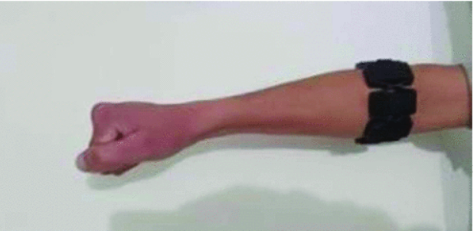
Technical aids for the employment of persons with disabilities——EMG
EMG controls drones to help with agricultural irrigation tasks
Notes:
Myo-armband was placed on the forearm gripping tight enough to examine any type of contraction and relaxation of the muscles. Specific gestures performed by the muscles would cause contraction and relaxation in muscles generating EMG signals. The signals varied for different gestures. The goal was to discriminate these signals with respect to their specific gestures and to use them as command signals for the quadcopter.

Slide 13
PART THREE
System Explanation
Notes:
Hello I’m Leo, next I will introduce the part of System Explanation, which is mainly written by me and zhuzhu. This part mainly introduces Aims and the functions of the system and block diagram of the system.

Slide 14
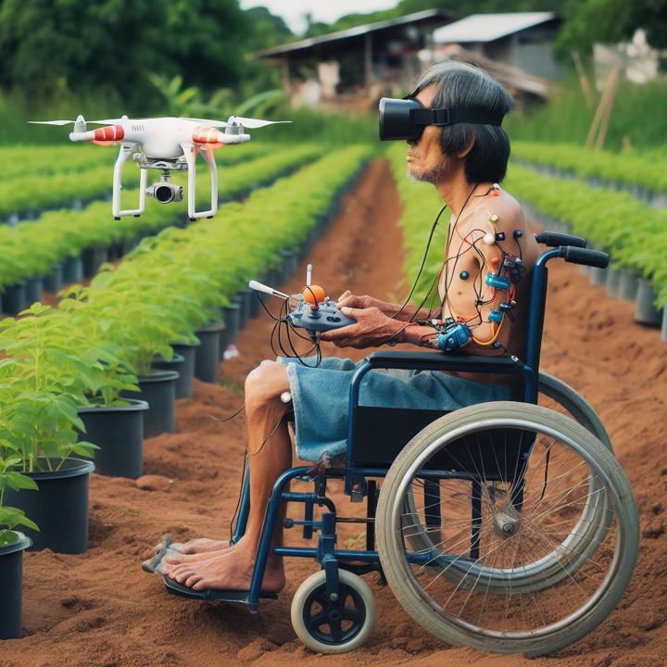
Aim of the System
01
Reducing Inequality
02
Promote Agricultural Production Efficiency
03
Protecting the health of people with disabilities
Source: Bing AI
Notes:
The overall goal of （按）this system is to first solve the employment problem of people with disabilities in the third world to reduce inequality, （按）increase food production by controlling drone irrigation to reduce hunger, （按）and provide better health testing and higher-end employment for people with disabilities.

Slide 15
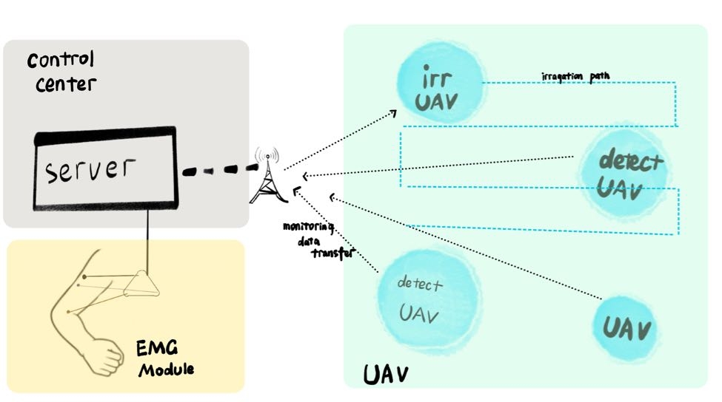
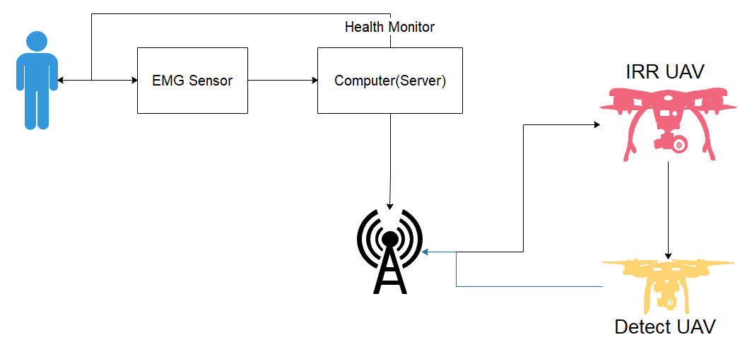
Function and Block Diagram of the System
Function of the System
Overall Block Diagram
Notes:
Next, let’s first explain the following functions that the entire system wants to achieve. This diagram is similar to (比较)the system’s Overall Block Diagram principle. First,（肌肉） EMG receives human muscle signals. EMG amplifies the signals and then transmits the signals to the computer through WiFi. （服务器）The computer uses matlab Process and identify the body status information, and then upload the electromyographic signal to the cloud server through the network. （电视塔）The cloud server transmits it to the irrgation UAV and detect UAV through the mqtt protocol to realize drone irrigation. This is just a rough look at the system.

Slide 16
PART FOUR
Function of Subsystem
Notes:
Next I will introduce the part of Function of Subsystem, which is mainly written by me and zhuzhu. This part mainly introduces the subsystem like the EMG system and UAV system.

Slide 17
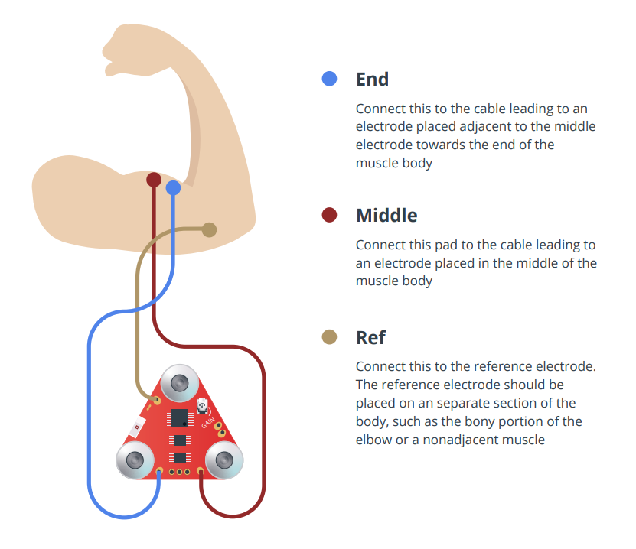
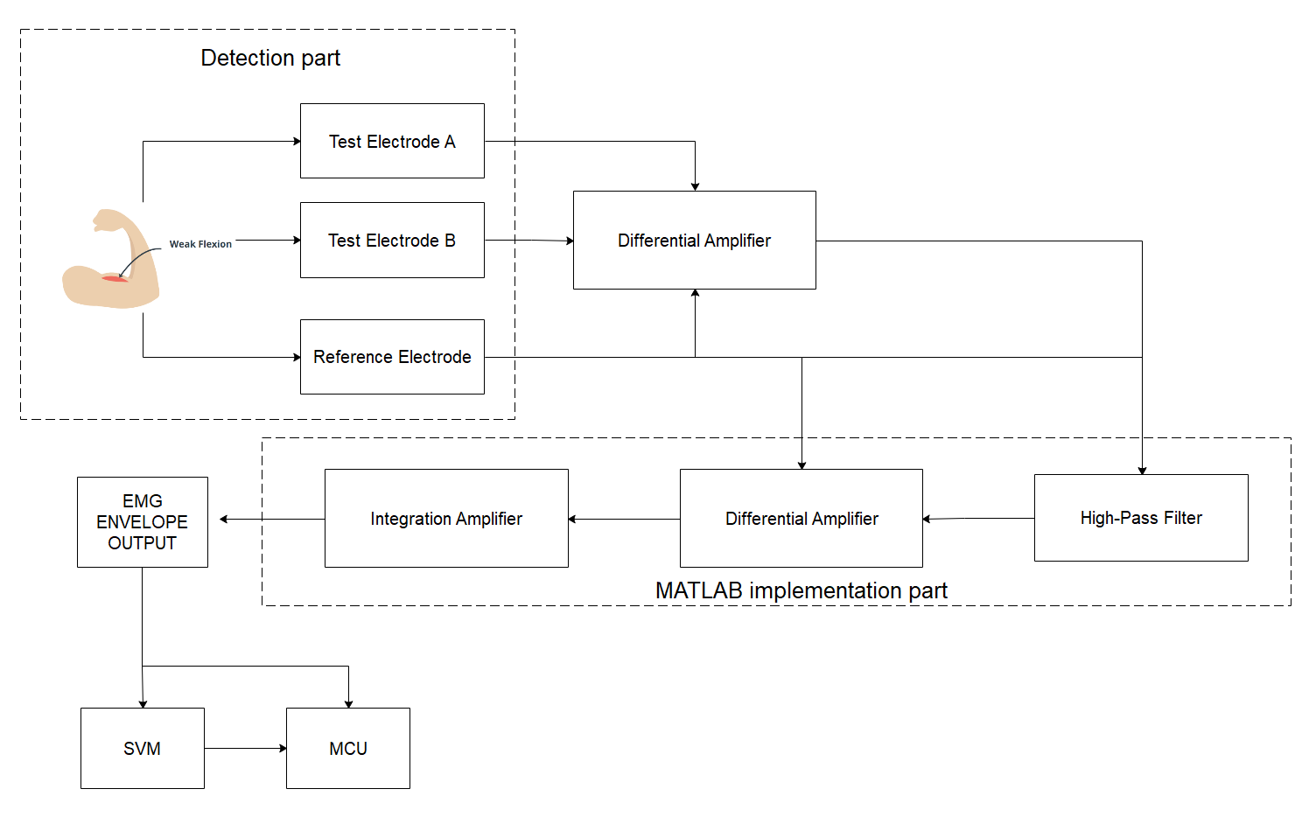
Function of Subsystem
EMG
Simulation of EMG sensors
Block diagram of EMG subsystem
Source: MyoWare 2.0 QuickStartGuide
Notes:
The first subsystem of the system is the electromyography system. We first simulate the connection of the myoelectric sensor: （第1张图）the myoelectric sensor has three electrodes, two are test electrodes and one is the reference electrode. Once they are connected to their respective locations, （2.差分放大）we will use a differential amplifier to remove the noise and focus only on the differences in the muscle signals. （MATLAB部分）Once we get this signal, we enter MATLAB. In MATLAB, we will simulate the functions of the high-pass filter, differential amplifier, lead-lag rectifier and integrating amplifier in sequence, and finally obtain an envelope electromyographic output.

Slide 18
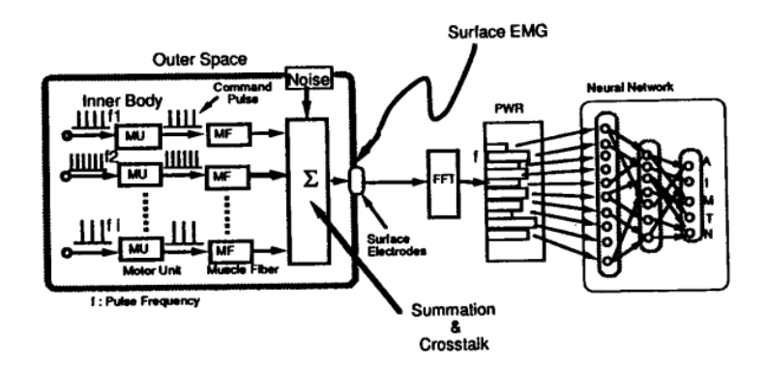
Function of Subsystem
EMG
Preprocessing and feature extraction of EMG signals
Improve signal-to-noise ratio
FFT can help identify and filter out noise
Recognize muscle fatigue
FFT helps diagnose specific neuromuscular diseases
Fast and efficient
FFT is a very efficient algorithm that can quickly convert time domain signals to frequency domain.
Source:;: Hiraiwa, Akira, Katsunori Shimohara, and Yukio Tokunaga. "EMG pattern analysis and classification by neural network." Conference proceedings., IEEE international conference on systems, man and cybernetics. IEEE, 1989
Notes:
Before that, （标题）we must first solve the preprocessing of the EMG signal. In order to deal with the problem in the frequency domain, we prefer to use FFT to preprocess the EMG signal. There are many benefits to using FFT,（第一个好处） including helping to analyze and filter out noise, （第二个好处）and also analyzing the frequency characteristics of muscle activity to identify muscle fatigue,（第三个好处） as well as the fast and effective characteristics we are all familiar with.

Slide 19
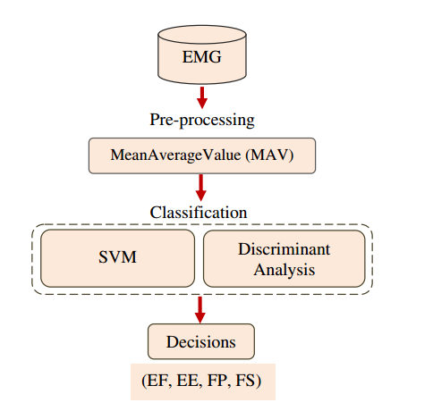
Function of Subsystem
EMG
Comparison between SVM and neural network
添加标题内容
Neural Network
SVM
Source: Alkan, Ahmet, and Mücahid Günay. "Identification of EMG signals using discriminant analysis and SVM classifier." Expert systems with Applications 39.1 (2012): 44-47.
Notes:
After solving the signal preprocessing, in order to realize the recognition of different muscle parts, we must identify the muscle patterns of different parts in a targeted manner. （天平轻）Naturally, we will think of using neural networks to solve the signal recognition problem. However, in the traditional sense The neural network algorithm on the Internet requires a large number of data sets. （右边）After comparison, we chose the Support vector machine (SVM), which can be implemented with only a small number of data sets, to identify myoelectric signals.

Slide 20
Function of Subsystem
01
单击此处可编辑内容单击此处可
02
单击此处可编辑内容单击此处可
03
单击此处可编辑内容单击此处可
04
单击此处可编辑内容单击此处可
Notes:
We can collect EMG signals to detect muscle activity, transmit them to a server, and then use them to control a drone. Next, I will discuss the drone part

Slide 21
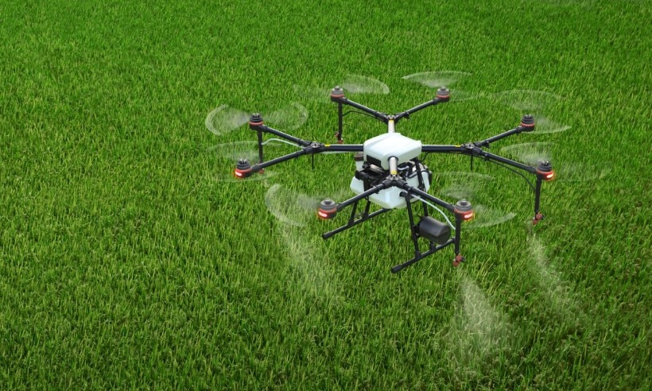
Function of Subsystem
UAV
FPV (First-person view) system
Multiple PID controller
01
单击此处可编辑内容单击此处可
02
单击此处可编辑内容单击此处可
03
单击此处可编辑内容单击此处可
04
单击此处可编辑内容单击此处可
Notes:
UAV are remotely operated using an FPV (First-person view) system. The design control system is improved to enhance time response and dynamic performance, ensuring robust stability. Drone flight is autonomously managed multiple PID (proportional-integral-derivative) controllers

Slide 22
Function of Subsystem
UAV
Camera , Sensors
Phantom 4 Pro Drone (DJI)
Detect UAV
Cameras, sensors, and irrigation tools
A four-wheel-drive drone
Specially used for irrigation
Irrigation UAV
Notes:
Our main drones are divided into two types: Detect UAV and Irrigation UAV
Detect UAV: contains camera and sensor which is a phantom 4 pro drone. It is used to detect terrain, humidity, and environment.
And used for precise irrigation.
Irrigation UAV : : contains camera, sensor and irrigation tools which is a four-wheel-drive drone
. Specially used for irrigation

Slide 23
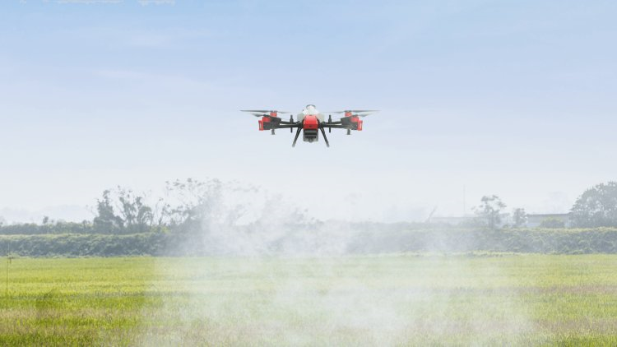
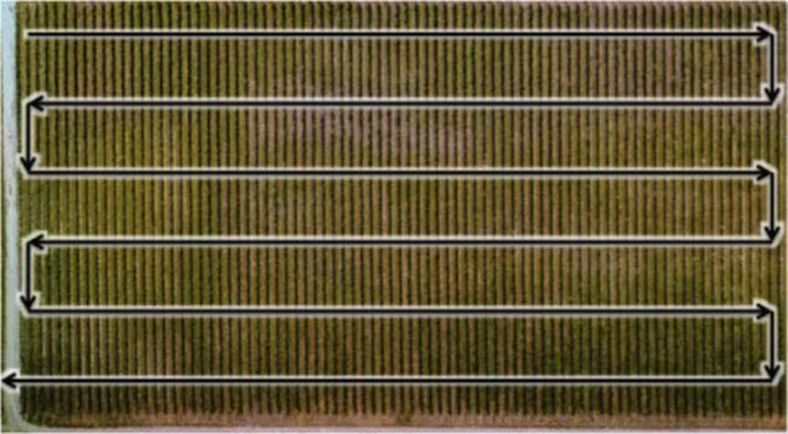
Function of Subsystem
Irrigation UAV
Crop Water Stress Index (CWSI) images
Notes:
Irrigation UAV defines the location function of the irrigation drone based on the Crop Water Stress Index (CWSI) images derived from the detect UAV. These tracks are a grid network, the speed of the irrigating drone changes according to the crop water stress conditions, achieving precision irrigation in the end

Slide 24
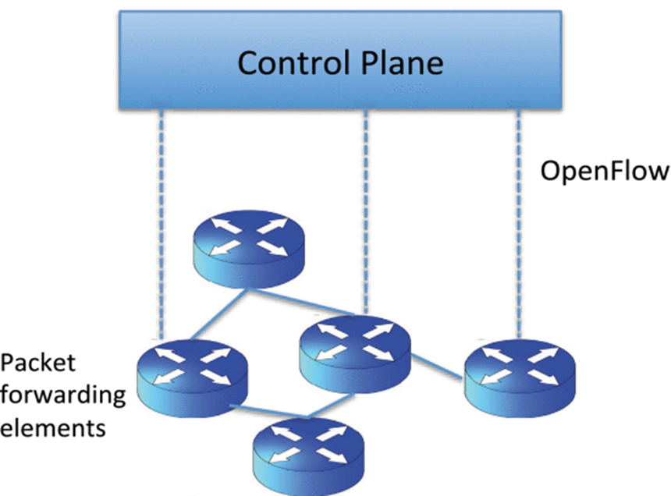
UAV Communication
SDN-
OpenFlow
Notes:
SDN (Software-Defined Networking) simplifies drone-operator communication, allowing easy deployment, network policy adjustments, and performance enhancements.
OpenFlow optimizes mobile network resources, enabling automated operations and quick service introductions. Additionally, a mobile management scheme using PMIPv6 and WAVE ensures seamless vehicular communication.
Software-Defined Networking (SDN) is an innovative networking approach that aims to make network management more flexible and efficient. Unlike traditional networks where the control and data planes are integrated, SDN separates these two layers. The control layer is centralized in SDN, allowing network administrators to shape traffic and deploy services across the entire network from a single, central control point. This architecture simplifies network design and operation, offers greater programmability, and enables more dynamic allocation of network resources, thus facilitating the implementation of advanced networking functionalities and services.

Slide 25
PART FIVE
Conclusion

Slide 26
Conclusion
EMG-UAV
integrating UAV technology with EMG-based controls for precision agriculture.
Address the SDGs of Zero Hunger, Good Health and Well-being, and Reduced Inequalities
Team collaboration
Notes:
Our Phase 2 exploration has led us to significant advancements in integrating UAV technology with EMG-based controls for precision agriculture. This approach not only promises to enhance crop productivity but also opens new pathways for employing disabled individuals, directly addressing the SDGs of Zero Hunger, Good Health and Well-being, and Reduced Inequalities. The collaborative effort amongs our team in developing the UAV and EMG components, respectively, underscores the power of interdisciplinary teamwork.

Slide 27
Reference List
[1 ] UM Rao Mogili, B B V L Deepak,Review on Application of Drone Systems in Precision Agriculture,Procedia Computer Science,Volume 133,2018,Pages 502-509,ISSN 1877-0509
[2 ] Tsouros, D.C.; Bibi, S.; Sarigiannidis, P.G. A Review on UAV-Based Applications for Precision Agriculture. Information 2019, 10, 349.
[3 ] Hopkins, M. The Role of Drone Technology in Sustainable Agriculture.
[4 ] Carolan, M. Publicising Food: Big Data, Precision Agriculture, and Co-Experimental Techniques of Addition: PublicisingFood. Sociol. Ruralis 2017, 57, 135–154.
[5 ] Brisco, B.; Brown, R.J.; Hirose, T.; McNairn, H.; Staenz, K. Precision Agriculture and the Role of Remote Sensing: A Review. Can.J. Remote Sens. 1998, 24, 315–327.
[6 ]L. F. Sanchez, H. Abaunza, and P. Castillo, “Safe navigation control for a quadcopter using user’s arm commands,” International Conference on Unmanned Aircraft Systems (ICUAS) June 13-16, 2017, Miami, FL, USA, 2017.
[7 ] E. M. Weiss, C. G. Kohler, J. Vonbank, E. Stadelmann, G. Kemmler, H. Hinterhuber, et al., "Impairment in emotion recognition abilities in patients with mild cognitive impairment, early and moderate Alzheimer disease compared with healthy comparison subjects," Am J Geriatr Psychiatry, vol. 16, pp. 974-80, Dec 2008.
[8 ] A. I. Meigal, S. Rissanen, M. P. Tarvainen, P. A. Karjalainen, I. A. Iudina-Vassel, O. Airaksinen, et al., "Novel parameters of surface EMG in patients with Parkinson's disease and healthy young and old controls," J Electromyogr Kinesiol, vol. 19, pp. e206-13, Jun 2009.
[9 ] C. DeLuca, R. LeFever, M. McCue, and A. Xenakis, “Behaviour of human motor units in different muscle during linear-varying contractions”, J. Physiol. (London), 329 (1982), pp. 113-128.
[10]Li Peilin. Employment and Institutional Change - The Job Search Process of Two Disadvantaged Groups [M]. Hangzhou: Zhejiang People's Publishing House, 2000.
[11]Zou Bo and Yang Lixiong: The Development of Welfare Enterprises and the Reform of Employment Policies for Persons with Disabilities, People's Publishing House, 2018 Edition, p. 137.
[12]Li Jing, "The Experience and Inspiration of Employment Support for People with Disabilities in the U.S.-Taking Boston as an Example," in Journal of Northwestern University (Philosophy and Social Science Edition), Vol. 49, No. 4, 2019.
[13]FAN Y and YIN Y, "Active and Progressive Exoskeleton Rehabilitation Using Multisource Information Fusion From EMG and Force-Position EPP," in IEEE Transactions onBiomedical Engineering, Dec. 2013, 60(12): 3314-3321.
[14]K. Zimenko, A. Margun and A. Kremlev, "Real-Time Classification for Robotics and HMI", 18th International Conference on Methods & Models in Automation & Robotics (MMAR), 2013.
[15]J. Bolin, J. Hoffman, C. Crawford, S. Beckmann and W. Macke, "Gesture-Based Control of Autonomous UAVs (Extended Abstract)", Proc. of the 16th International Conference on Autonomous Agents and Multiagent Systems (AAMAS 2017), pp. 1484-1486, 2017.

Slide 28
Reference List
[16]M. T. Wolf, C. Assad, M. T. Vernacchia, J. Fromm and H. L. Jethani, "Gesture-based robot control with variable autonomy from the JPL BioSleeve", 2013 IEEE International Conference on Robotics and Automation, pp. 1160-1165, 2013.
[17]S. Bitzer and P. V. D. Smagt, "Learning EMG control of a robotic hand: Towards Active Prostheses", IEEE International Conference on Robotics and Automation Orlando, 2016.
[18] Hafid, Abdelakram, et al. "EMG & EIMG measurement for Arm & Hand motions using custom made instrumentation based on Raspberry PI." 2020 2nd International Workshop on Human-Centric Smart Environments for Health and Well-being (IHSH). IEEE, 2021.
[19]Khan, Sagheer, Kiran Khurshid, and Muhammad Zceshan. "Emg data acquisition and flight control of quadcopter on different emg signals." 2019 14th Iberian Conference on Information Systems and Technologies (CISTI). IEEE, 2019.
[20]Mohammed, Noor, Zayed Ahmed, and Raquib-ul Alam. "Design and development of low-cost EMG amplifier for assistive technology." 2017 IEEE International Conference on Power, Control, Signals and Instrumentation Engineering (ICPCSI). IEEE, 2017.
[21]Hiraiwa, Akira, Katsunori Shimohara, and Yukio Tokunaga. "EMG pattern analysis and classification by neural network." Conference proceedings., IEEE international conference on systems, man and cybernetics. IEEE, 1989.
[22]Hafid, Abdelakram, et al. "EMG & EIMG measurement for Arm & Hand motions using custom made instrumentation based on Raspberry PI." 2020 2nd International Workshop on Human-Centric Smart Environments for Health and Well-being (IHSH). IEEE, 2021.
[23]Fontanilla, José A., Jesús D. Urbano, and A. Luque. "Low-cost voltage amplifier for biological signal acquisition through generic micro-electrode array." 2021 13th Spanish Conference on Electron Devices (CDE). IEEE, 2021.
[24]Sadikoglu, Fahreddin, Cemal Kavalcioglu, and Berk Dagman. "Electromyogram (EMG) signal detection, classification of EMG signals and diagnosis of neuropathy muscle disease." Procedia computer science 120 (2017): 422-429.
[z1] Abdullahi, H.S., Mahieddine, F. and Sheriff, R.E. (2015) ‘Technology impact on agricultural productivity: A review of precision agriculture using unmanned aerial vehicles’, Wireless and Satellite Systems, pp. 388–400. doi:10.1007/978-3-319-25479-1_29.
[26]C. Albornoz and L. F. Giraldo, "Trajectory design for efficient crop irrigation with a UAV," 2017 IEEE 3rd Colombian Conference on Automatic Control (CCAC), Cartagena, Colombia, 2017, pp. 1-6, doi: 10.1109/CCAC.2017.8276401.
[27]Nhamo L, Van Dijk R, Magidi J, Wiberg D, Tshikolomo K. Improving the Accuracy of Remotely Sensed Irrigated Areas Using Post-Classification Enhancement Through UAV Capability. Remote Sensing. 2018; 10(5):712. https://doi.org/10.3390/rs1005071
[z4]Spyridon G. Kontogiannis, John A. Ekaterinaris,Design, performance evaluation and optimization of a UAV,Aerospace Science and Technology,Volume 29, Issue 1,2013,Pages 339-350,ISSN 1270-9638,https://doi.org/10.1016/j.ast.2013.04.005.
[29]Anderson, B.D.O., Fidan, B., Yu, C., Walle, D. (2008). UAV Formation Control: Theory and Application. In: Blondel, V.D., Boyd, S.P., Kimura, H. (eds) Recent Advances in Learning and Control. Lecture Notes in Control and Information Sciences, vol 371. Springer, London. https://doi.org/10.1007/978-1-84800-155-8_2
[30]L. Gupta, R. Jain and G. Vaszkun, "Survey of Important Issues in UAV Communication Networks," in IEEE Communications Surveys & Tutorials, vol. 18, no. 2, pp. 1123-1152, Secondquarter 2016, doi: 10.1109/COMST.2015.2495297.

Slide 29
Thanks

